Slide 1
By: Alaa refai zaid Al banna Mohammad abdelaziz
Model-Based PID Ball Balancing System

Slide 2
Introduction
System Components:
Servo motor
Ultrasonic sensor
Potentiometers
Arduino
System Function:
Adjusts the angle of a track to maintain the ball at a specific position.
Sensor and Control:
Ultrasonic sensor detects the ball's location.
PID controller corrects deviations to ensure stability.
Motor Function:
Servo motor moves the track vertically to guide the ball back to its designated position.
Software and Development:
Simulink-based software for prototype development, documentation, and presentations.

Slide 3
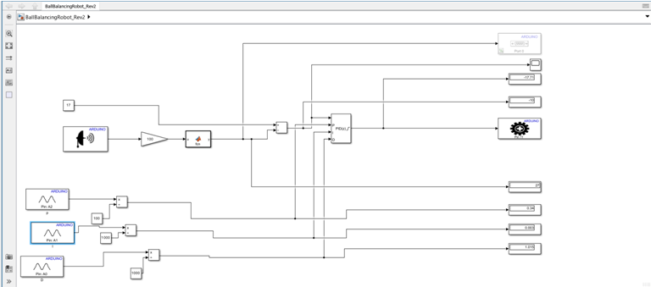
Simulink Design

Slide 4
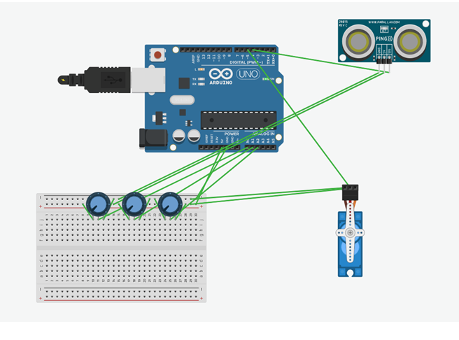
Circuit controlling the system

Slide 5
Physical Prototype
To test the efficiency of the controller, a physical prototype was built. The prototype mimics the desired ball-balancing. Figure 4 shows the prototype built.
To test the effectivness of the controller, a physical prototype was built. The prototype demonstrates the ball-balancing. The following slide shows the prototype built.

Slide 6
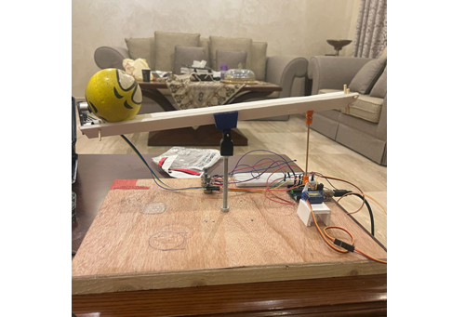
Physical Prototype

